Slide 1

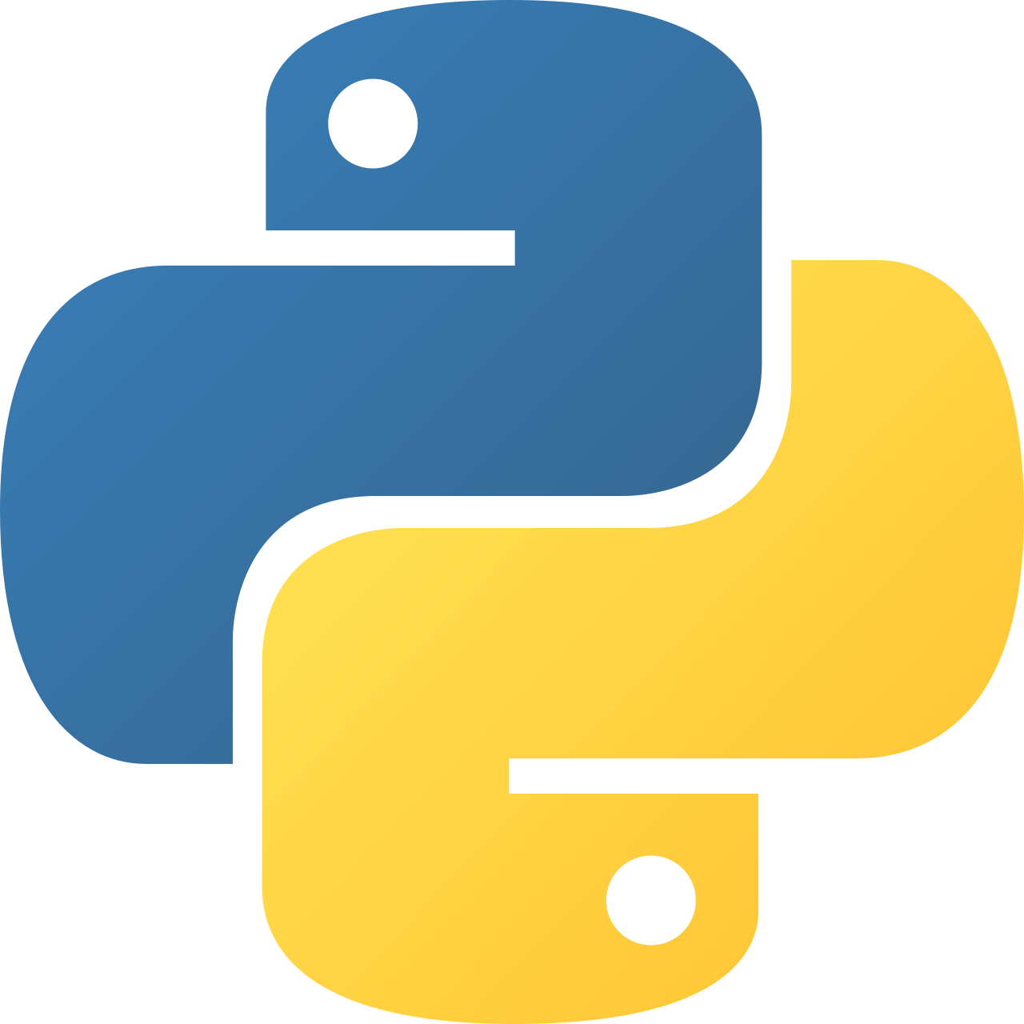
Intermediate Python
Packages & Relative Imports

Slide 2
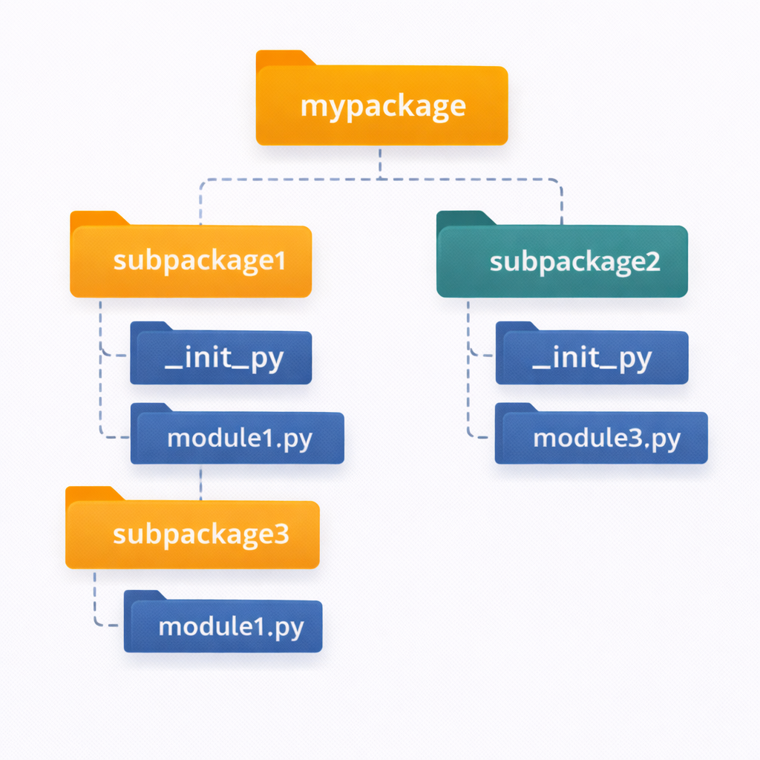
Packages & Relative Imports – Overview
Organizing large Python projects
Grouping related modules
Managing import paths cleanly
Understanding absolute vs relative imports
Avoiding common package issues
Notes:
Explain that packages are the next level of organization after modules and are essential for real-world applications.

Slide 3
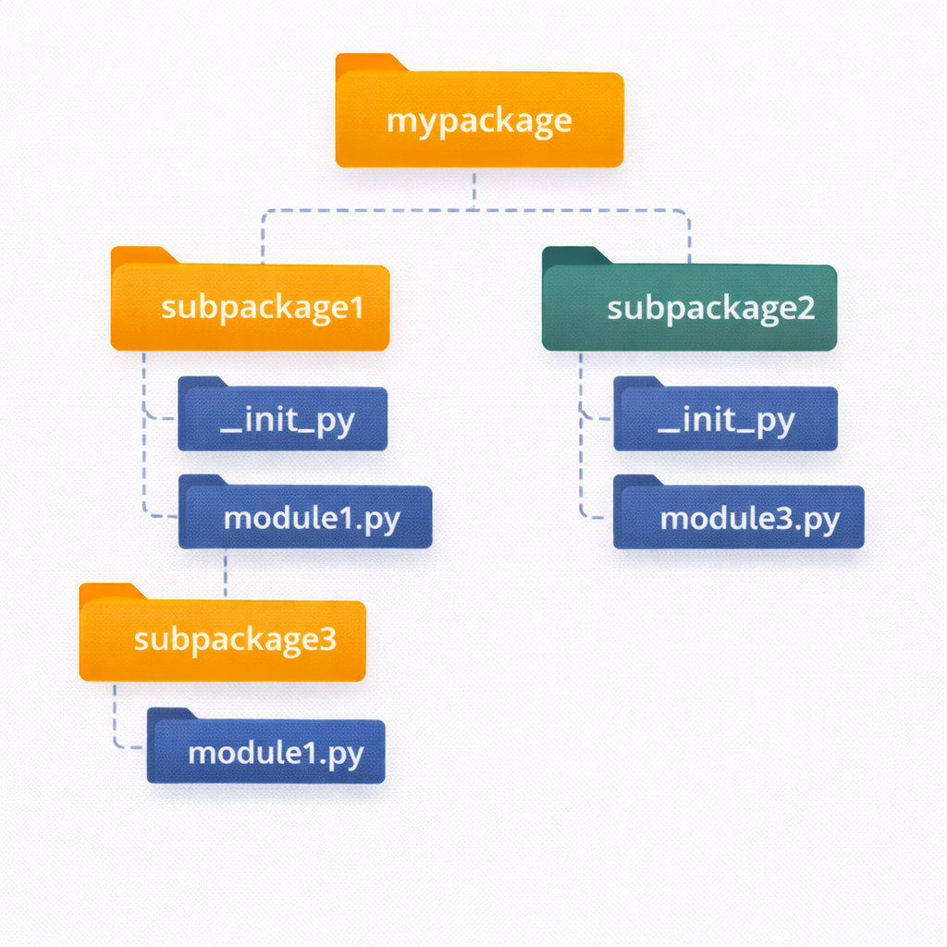
Package Structure
Packages are directories of modules
Folder name becomes package name
Can contain sub-packages
Improves project organization
Scales for large applications
Notes:
Walk through how Python treats directories as packages and how modules are accessed using dot notation.

Slide 4
Code Example
project/
│── main.py
│── mypackage/
│ ├── utils.py
│ └── helpers.py

Slide 5
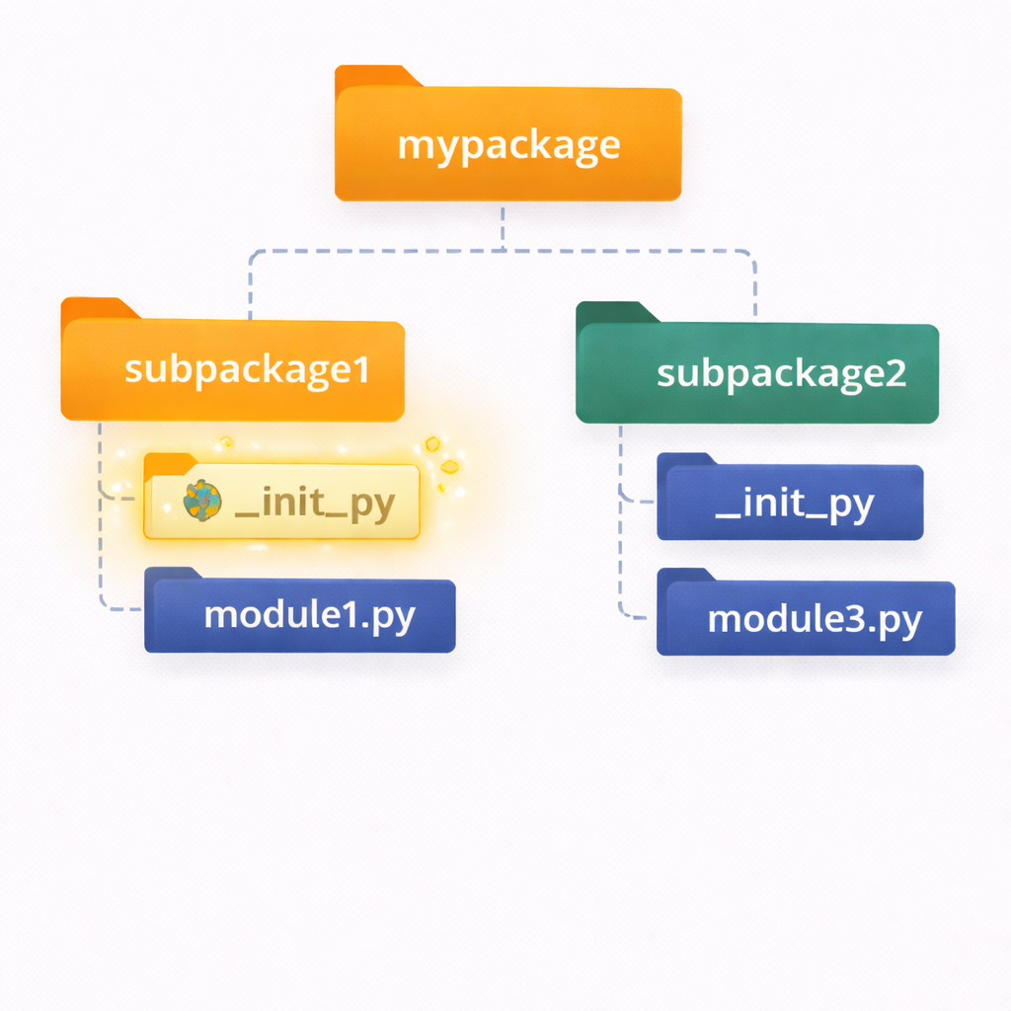
__init__.py
Marks directory as a package
Executes on package import
Can initialize package state
Controls exposed API
Optional in Python 3.3+
Code Example
# mypackage/__init__.py
from .utils import add
Notes:
Explain historical vs modern behavior. Emphasize that __init__.py is still widely used for clarity and control.

Slide 6
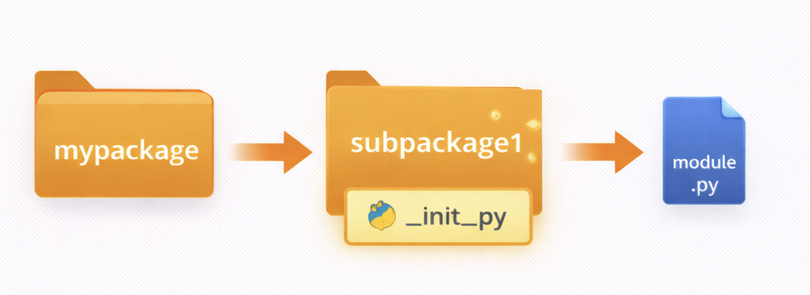
Absolute Imports
Full path from project root
Clear and explicit
Recommended approach
Easier to read and debug
Stable across refactoring
Code Example
from mypackage.utils import add
Notes:
Stress that absolute imports are preferred in most production code and avoid ambiguity.

Slide 7
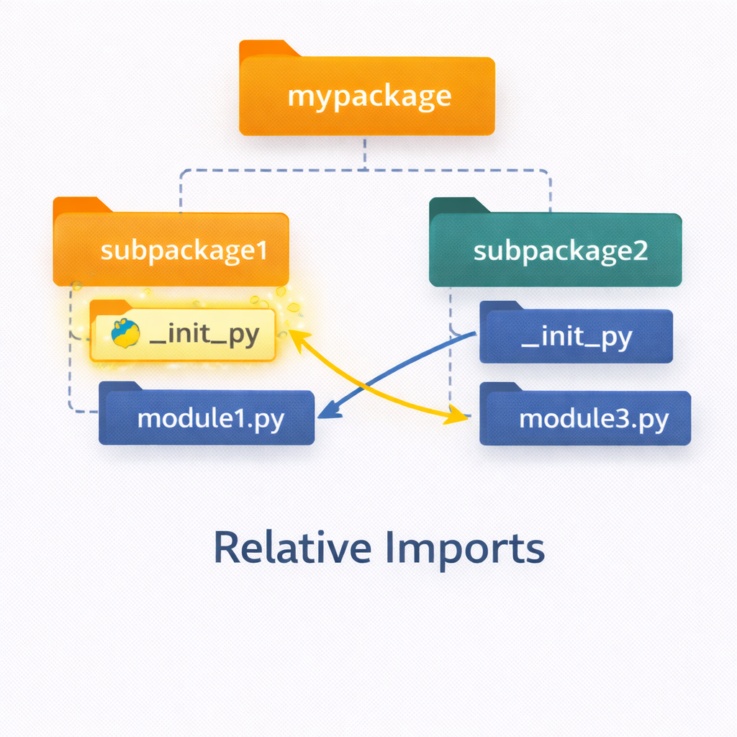
Relative Imports
Use dot notation (. and ..)
Relative to current package
Shorter import paths
Only work inside packages
Not usable in scripts
Code Example
from .utils import add
from ..common import config
Notes:
Clarify that relative imports fail when a file is run directly. Emphasize running packages using python -m.

Slide 8
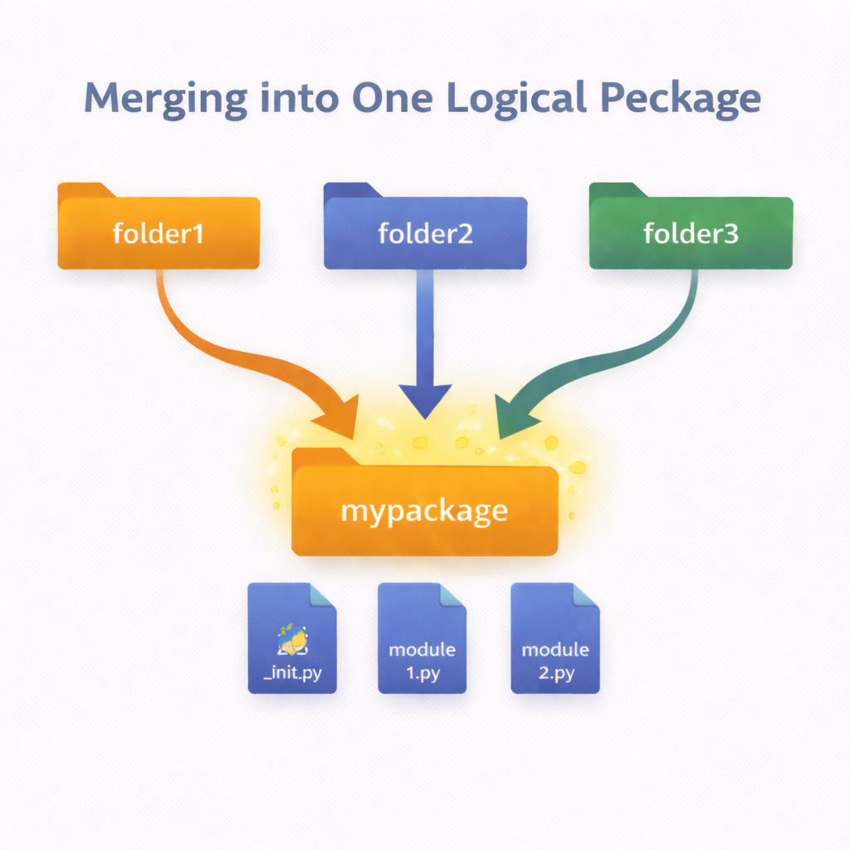
Namespace Packages (Python 3.3+)
Code Example
pkg_a/mypkg/module1.py
pkg_b/mypkg/module2.py
Packages without __init__.py
Spread across multiple directories
Useful for large frameworks
Automatically merged namespaces
Advanced use case
Notes:
Explain that namespace packages are powerful but usually unnecessary for beginners. Mention examples like large vendor libraries.

Slide 9
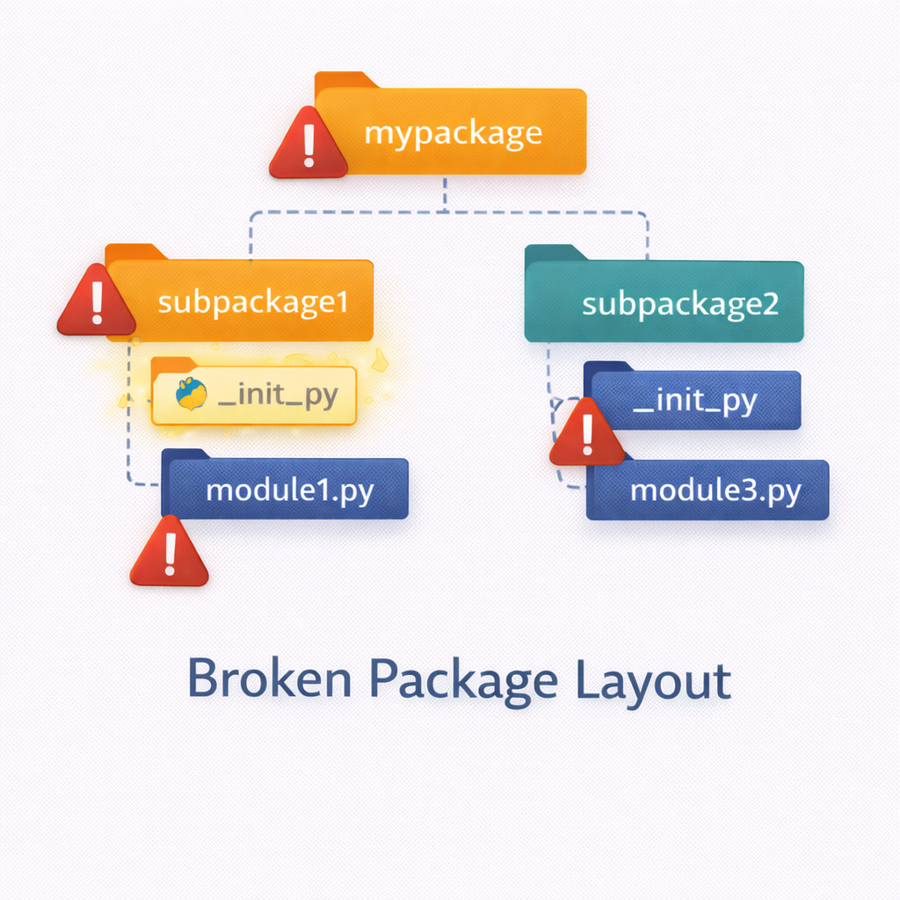
Package Lookup Rules
Code Example
import mypackage.utils
Python searches sys.path
Finds top-level package first
Resolves submodules step-by-step
Caches loaded packages
Errors raise ModuleNotFoundError
Notes:
Tie back to Session 1’s sys.path. Explain how Python resolves each part of a dotted import.

Slide 10
Common Pitfalls
Code Example
python utils.py # causes import errors
Running modules directly
Incorrect relative imports
Missing __init__.py
Name conflicts with stdlib
Broken project structure
Notes:
Share real-world mistakes. Emphasize correct execution methods and clean structure.

Slide 11
Best Practices
Prefer absolute imports
Use __init__.py intentionally
Avoid wildcard imports
Keep package structure simple
Test imports early
Code Example
python -m mypackage.module
Notes:
Reinforce habits students should carry forward into professional development.

Slide 12
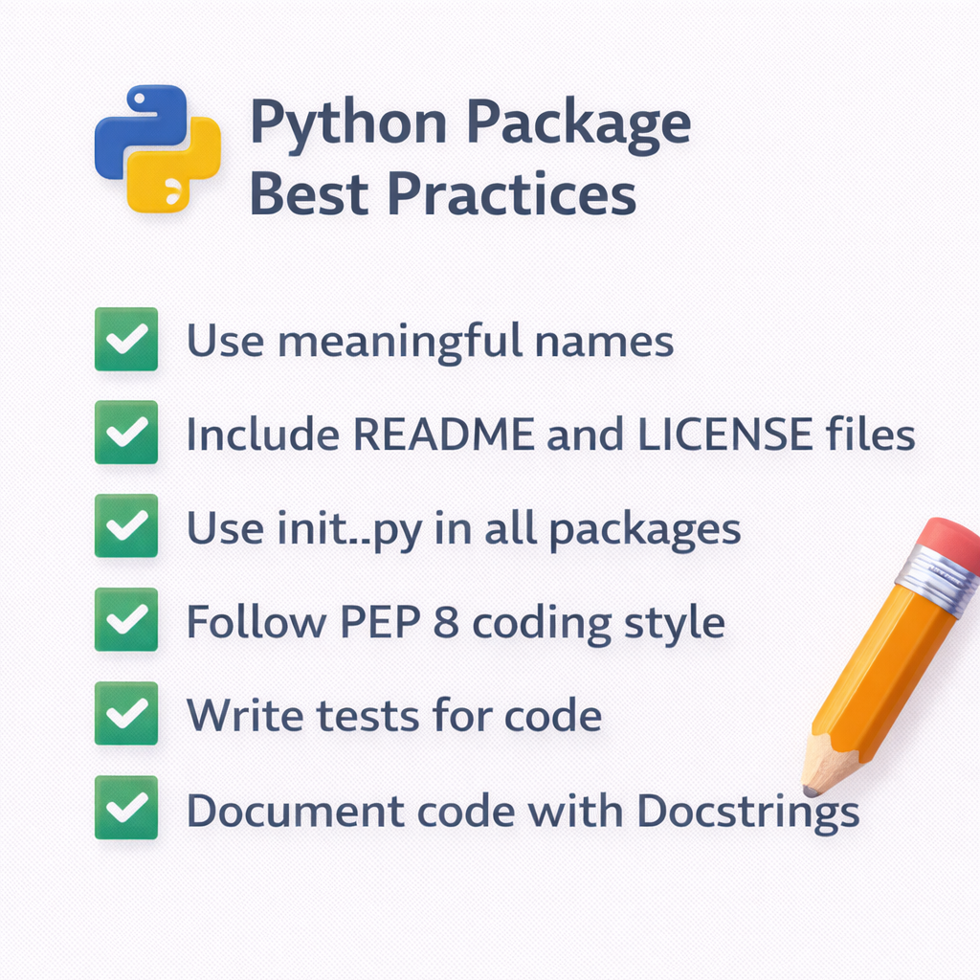

Slide 13
Session Summary – Packages & Imports
Packages organize modules
__init__.py controls behavior
Absolute imports are preferred
Relative imports have limits
Structure prevents import errors
Notes:
Wrap up by connecting packages to upcoming topics like virtual environments, pip, and project distribution.

